Slide 1


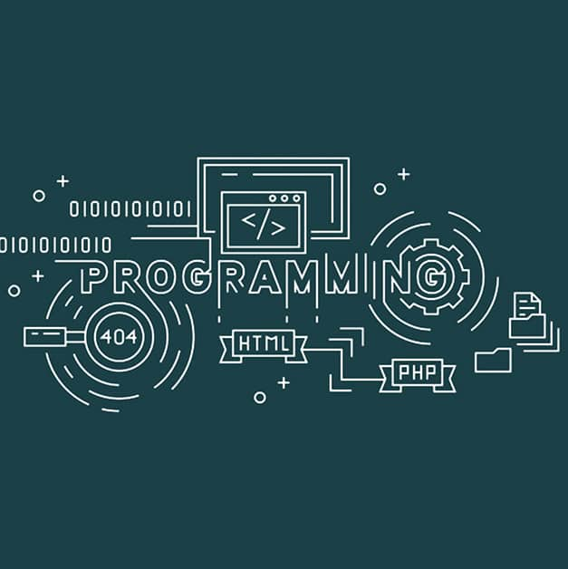
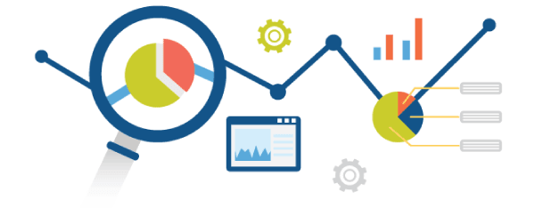

Data Analytics using Python.
Guido Van Rossum

Slide 2
What is Programming?
What is Programming Language?

Slide 3
What is Programming? : Writing a Program
What is Programming Language? : Is a Collection of Tokens.

Slide 4
Module-1: Python Basic Concepts and Programming :
Interpreter, Parts of Python Programming Language, Identifiers, Keywords, Statements and Expressions, Variables, Operators, Precedence and Associativity, Data Types, Indentation, Comments, Program Execution, Reading Input, Print Output, Type Conversions, The type( ) Function and Is Operator, Control Flow Statements, The if Decision Control Flow Statement, The if…else Decision Control Flow Statement, The if…elif…else Decision Control Statement, Nested if Statement, The while Loop, The for Loop, The continue and break Statements, Sequences – Strings, Built-In Functions, Commonly Used Modules, Function Definition and Calling the Function, The return Statement and void Function, Scope and Lifetime of Variables, Default Parameters, Keyword Arguments, *args and **kwargs, Command Line Arguments.

Slide 5
Module-2: Python Collection Objects, Classes :
Strings- Creating and Storing Strings, Basic String Operations, Accessing Characters in String by Index Number, String Slicing and Joining, String Methods, Formatting Strings, Lists-Creating Lists, Basic List Operations, Indexing and Slicing in Lists, Built-In Functions Used on Lists, List Methods. Sets, Tuples and Dictionaries. Files: reading and writing files. Class Definition – Constructors – Inheritance – Overloading.
Module-3: Data Pre-processing and Data Wrangling Acquiring Data with Python: Loading from CSV files, Accessing SQL databases. Cleansing Data with Python: Stripping out extraneous information, Normalizing data AND Formatting data. Combining and Merging Data Sets – Reshaping and Pivoting – Data Transformation – String Manipulation, Regular Expressions.

Slide 6
Module-4: Web Scraping And Numerical Analysis:
Data Acquisition by Scraping web applications –Submitting a form - Fetching web pages – Downloading web pages through form submission – CSS Selectors. NumPy Essentials: TheNumPy.
Module-5: Data Visualization with NumPy Arrays, Matplotlib, and Seaborn: Data Visualization: Matplotlib package – Plotting Graphs – Controlling Graph – Adding Text – More Graph Types – Getting and setting values – Patches. Advanced data visualization with Seaborn.- Time series analysis with Pandas.

Slide 7
Course Learning objectives:
Explain the basic of Python programming
Design real time application using Python collection Objects and classes
Familiarize the concept of Data Visualization with NumPy, Seaborn
Define the Web Scraping and Numerical Analysis

Slide 8
Course outcome (Course Skill Set):
At the end of the course the student should be able to :
Sl. No. | Description | Bloom's Level
CO1 | Understand and comprehend the basics of Python programming. | L2
CO2 | Apply knowledge in real time applications | L3
CO3 | Apply the Data Pre-processing & Data Wrapping | L3
CO4 | Demonstrate the Web Scraping And Numerical Analysis | L3

Slide 9
Suggested Learning Resources:
Books
Allen B. Downey, “Think Python: How to Think Like a Computer Scientist„„, 2nd edition,Updated for Python 3, Shroff/O„Reilly Publishers, 2016 (http://greenteapress.com/wp/thinkpython/)
Guido van Rossum and Fred L. Drake Jr, ―An Introduction to Python – Revised and updated for Python 3.2, Network Theory Ltd., 2011.
Jake Vander plas, “Python Data Science Handbook: Essential tools for working with data”, O„Reilly Publishers, I Edition.
Reference Books
Mark Lutz, “Programming Python”, O'Reilly Media, 4th edition, 2010.
Tim Hall and J-P Stacey, “Python 3 for Absolute Beginners”, Apress, 1st edition, 2009.
Magnus Lie Hetland, “Beginning Python: From Novice to Professional”, Apress, Second Edition, 2005.
4. Shai Vaingast, “Beginning Python Visualization Crafting Visual Transformation Scripts”, Apress, 2nd edition, 2014. 6. Wes Mc Kinney, “Python for Data Analysis”, O'Reilly Media, 2012.
Web links and Video Lectures (e-Resources): https://youtu.be/4SJ7bEILPJk.

